Slide 1

HAPTICS

Slide 2


Slide 3
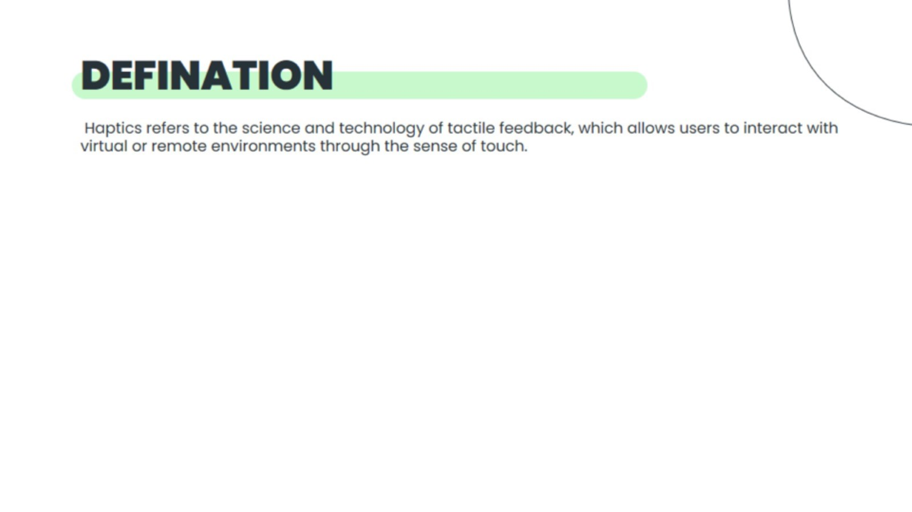
DEFINATION

Slide 4
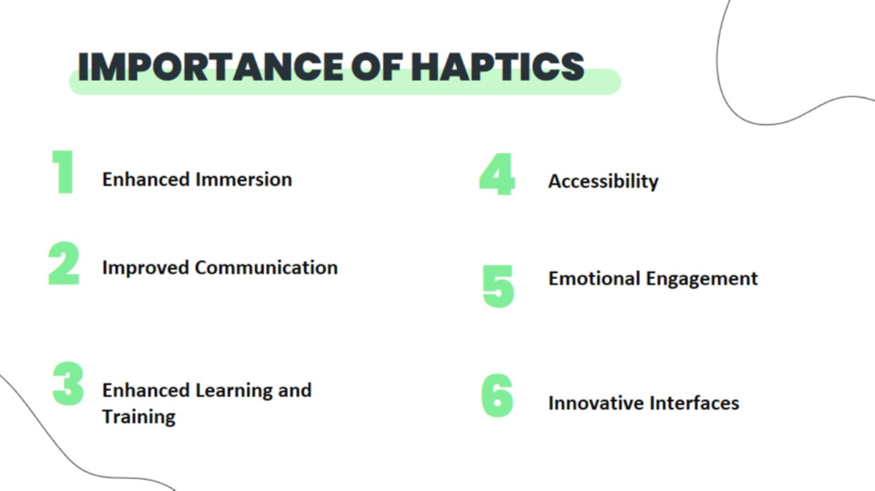
IMPORTANCE OF HAPTICS

Slide 5
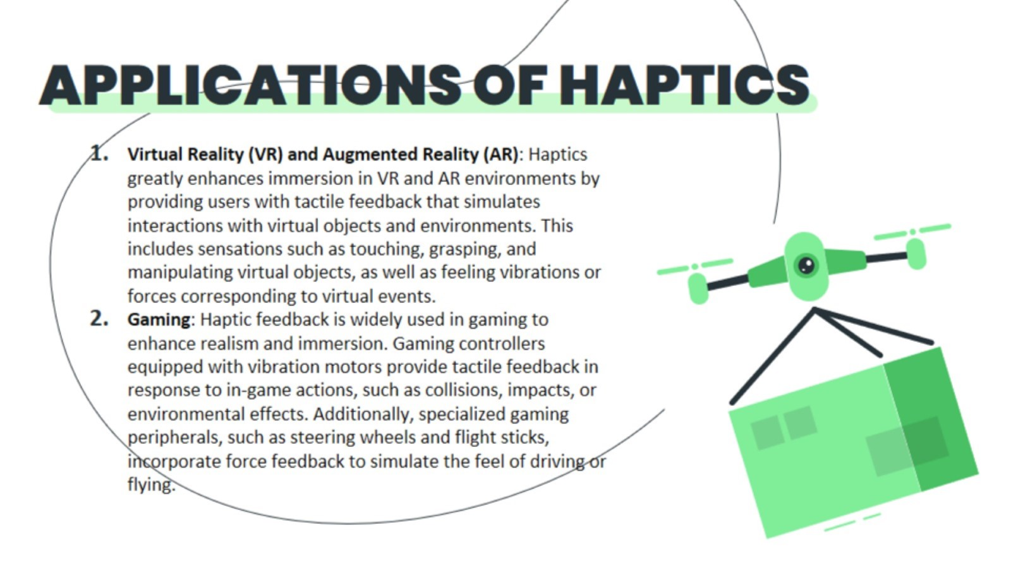
APPLICATIONS OF HAPTICS

Slide 6
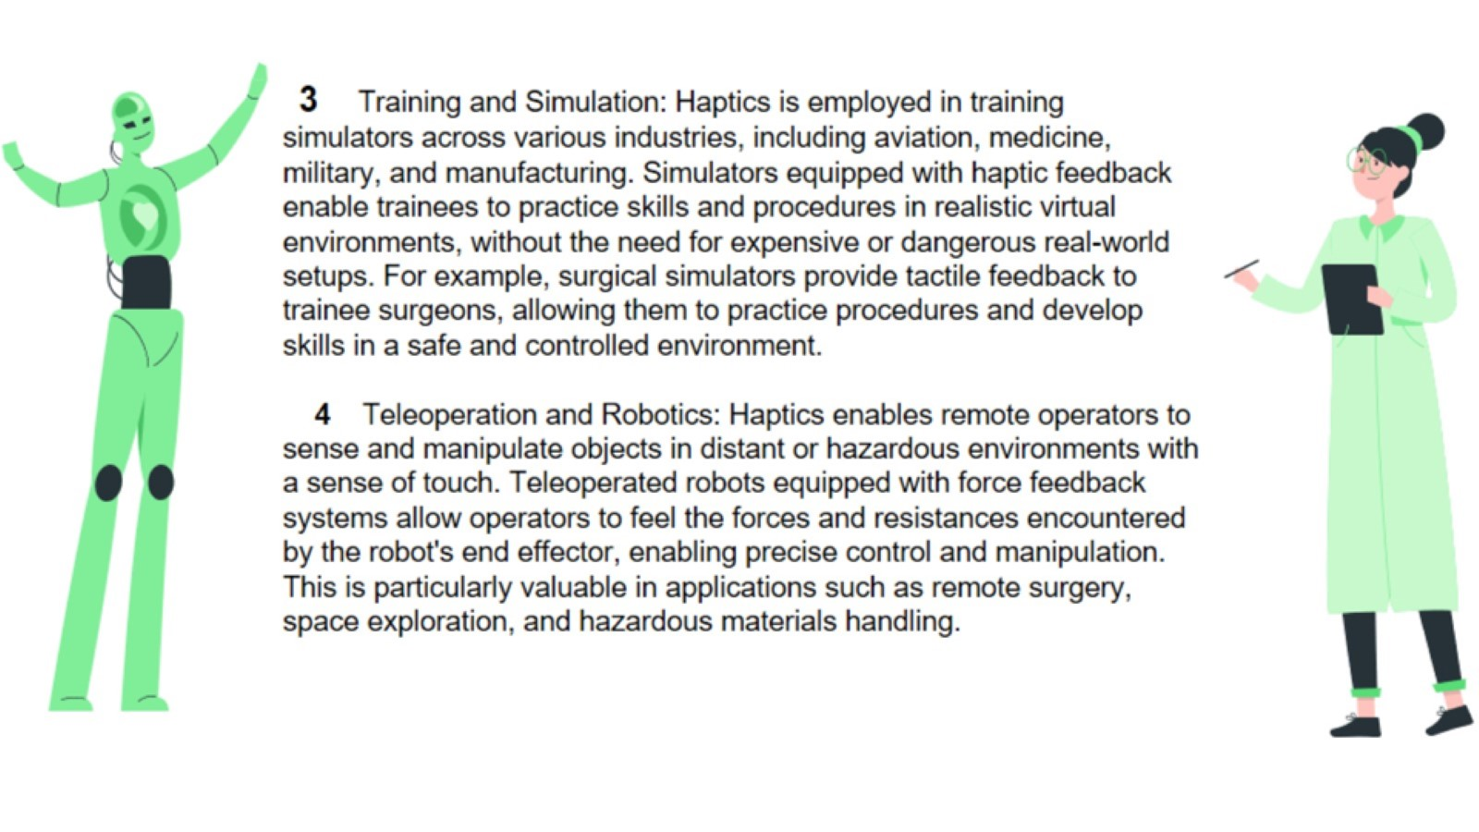

Slide 7
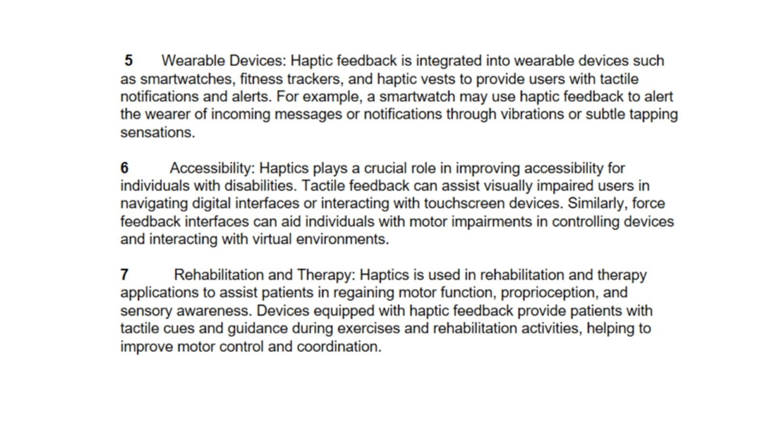

Slide 8
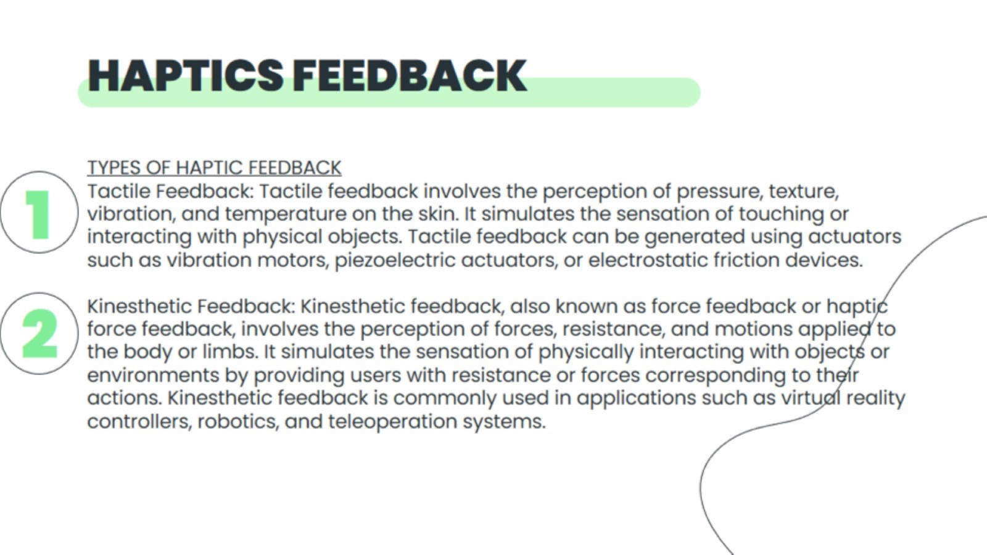
HAPTICS FEEDBACK

Slide 9
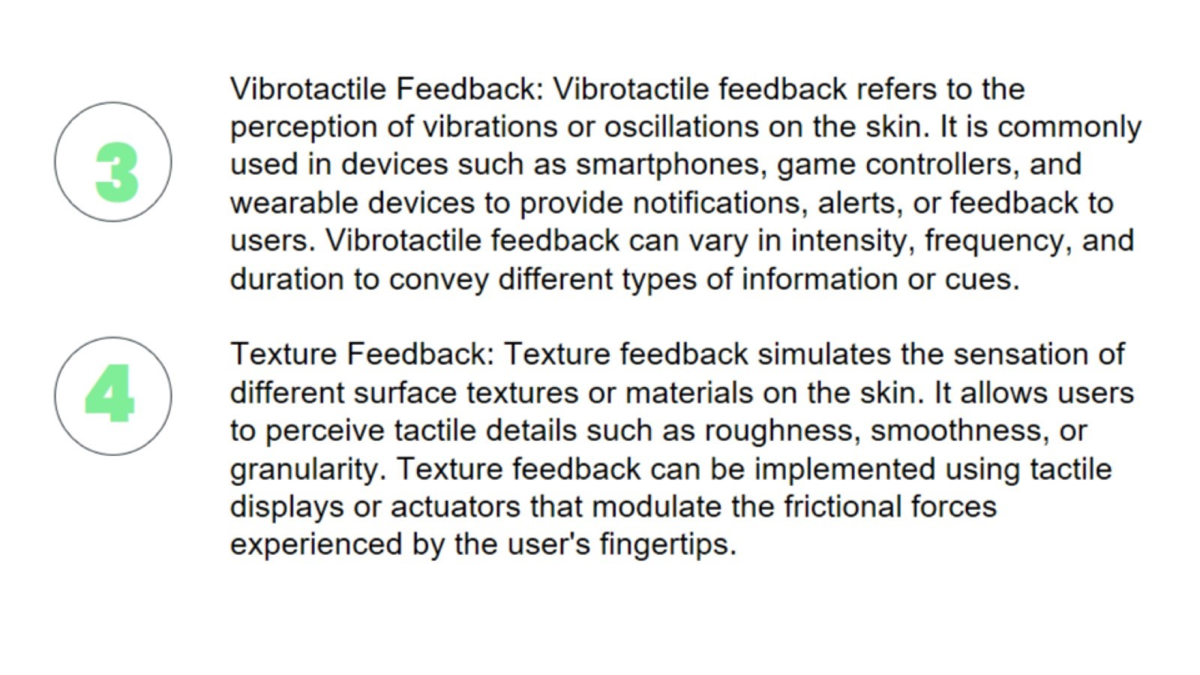

Slide 10
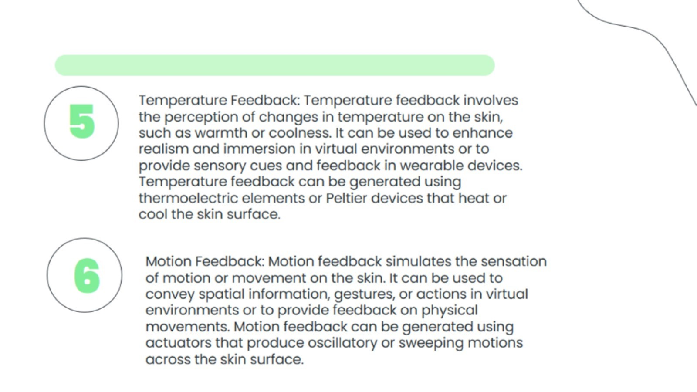
5

Slide 11
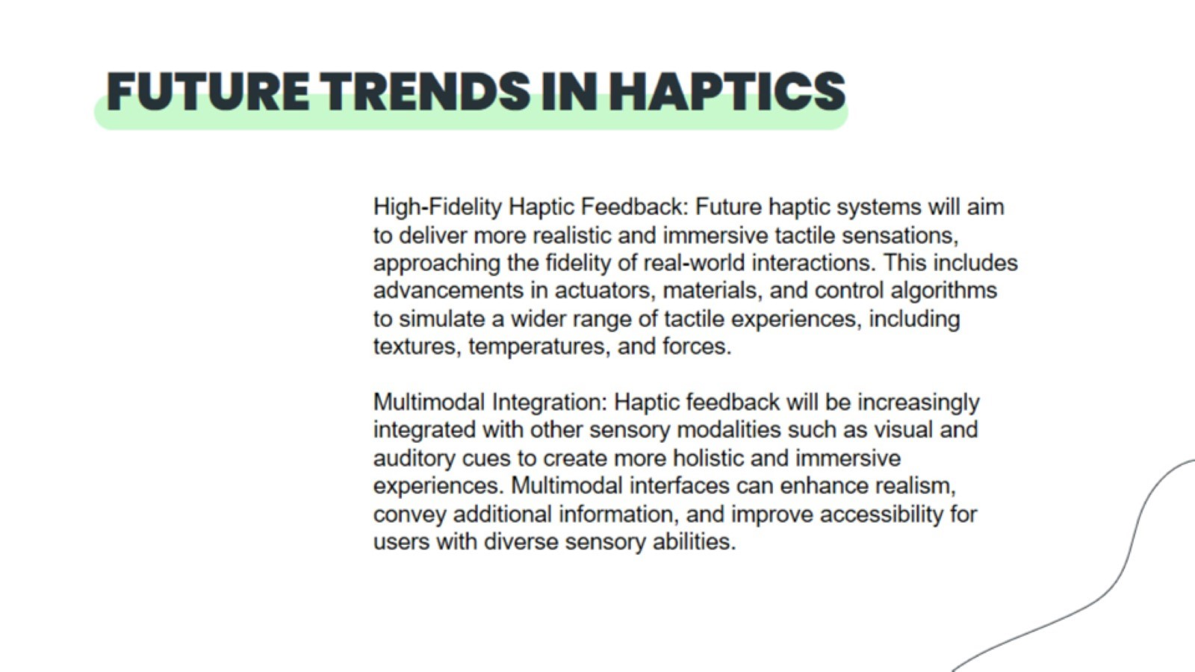
FUTURE TRENDS IN HAPTICS

Slide 12
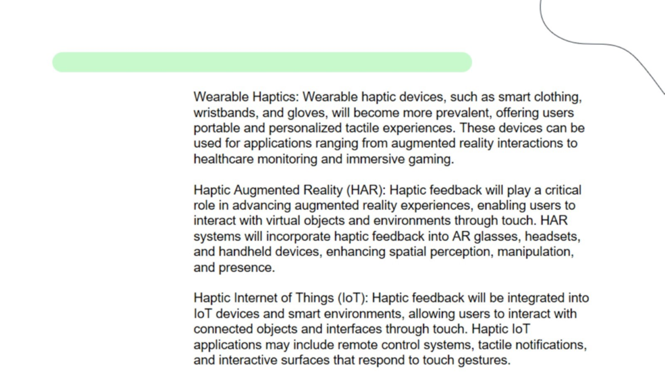

Slide 13
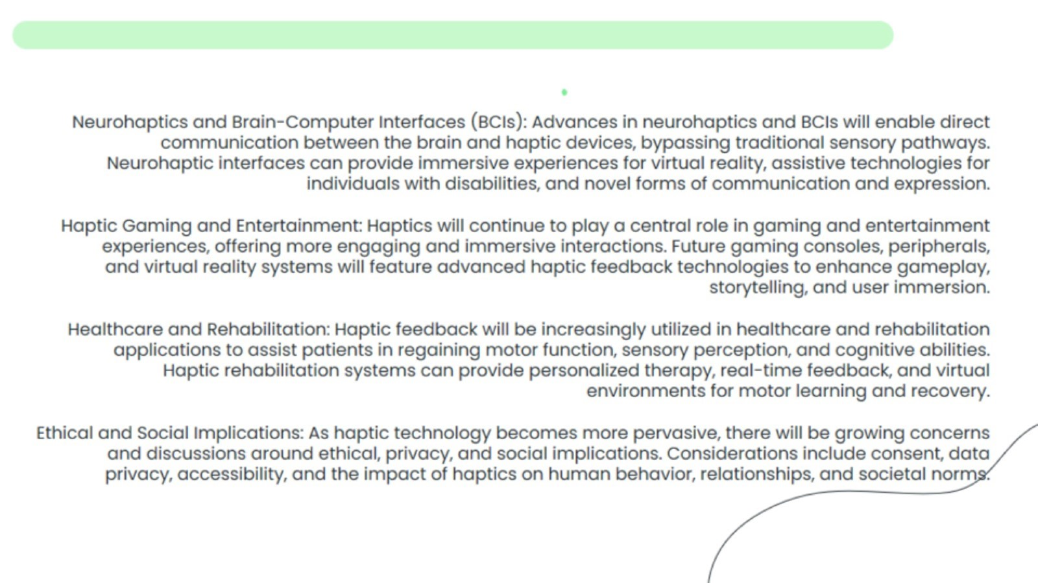

Slide 14
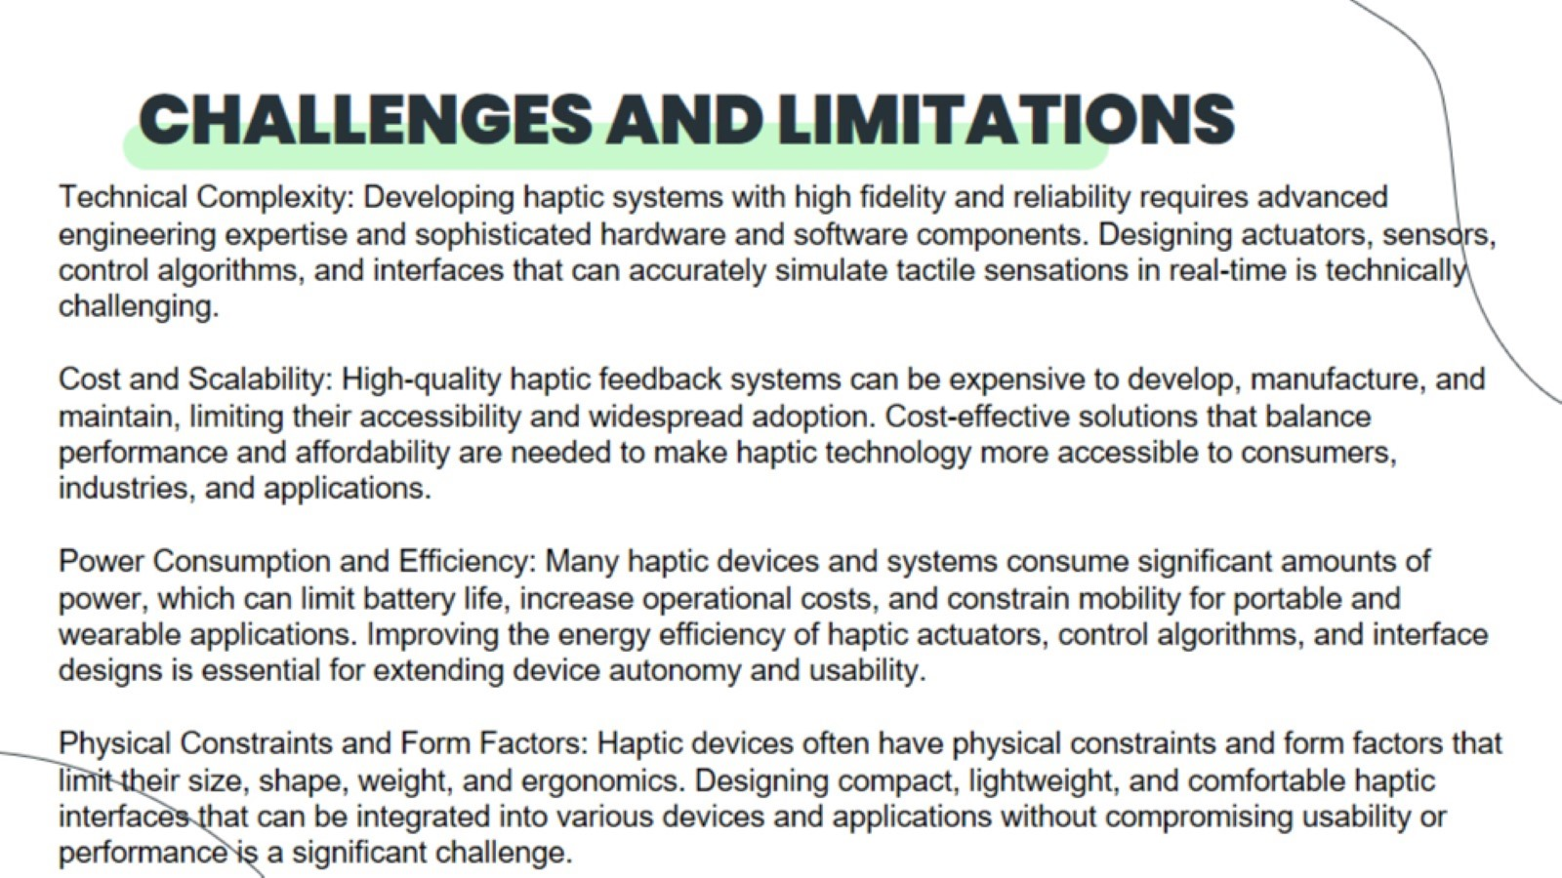
CHALLENGES AND LIMITATIONS

Slide 15
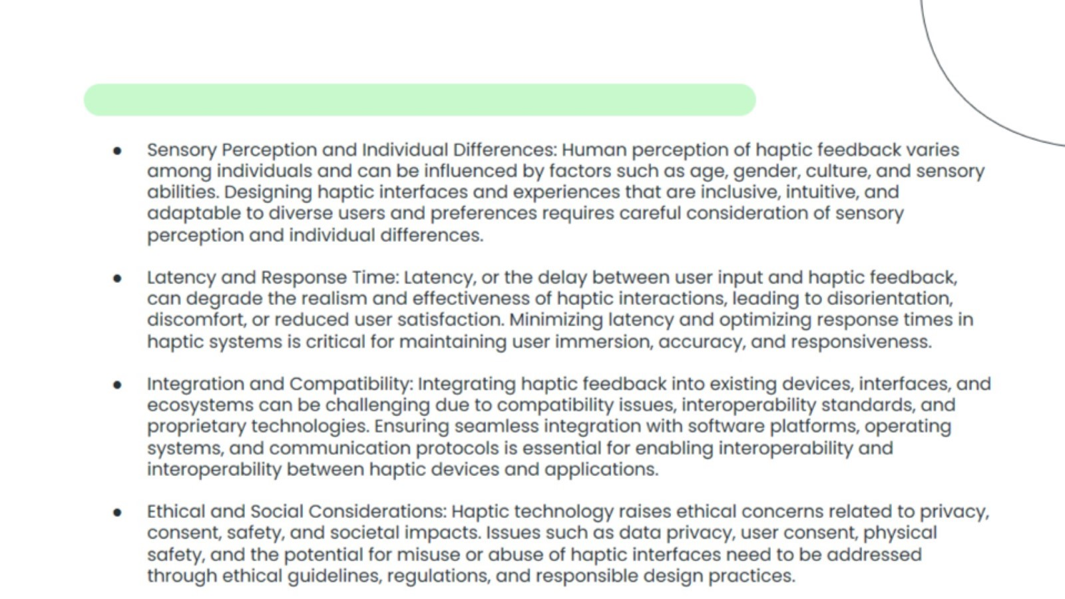

Slide 16
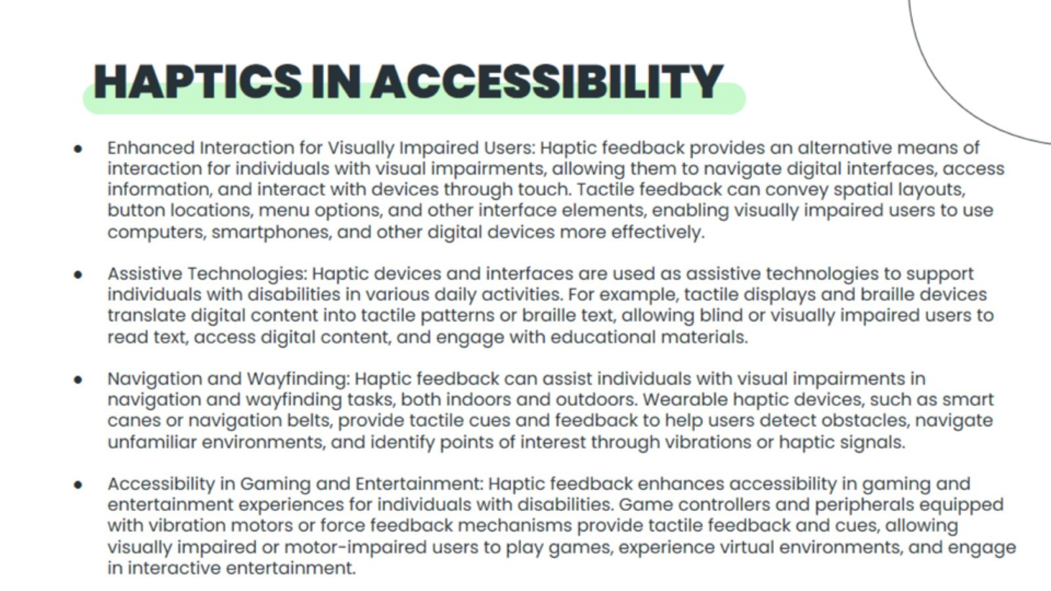
HAPTICS IN ACCESSIBILITY

Slide 17
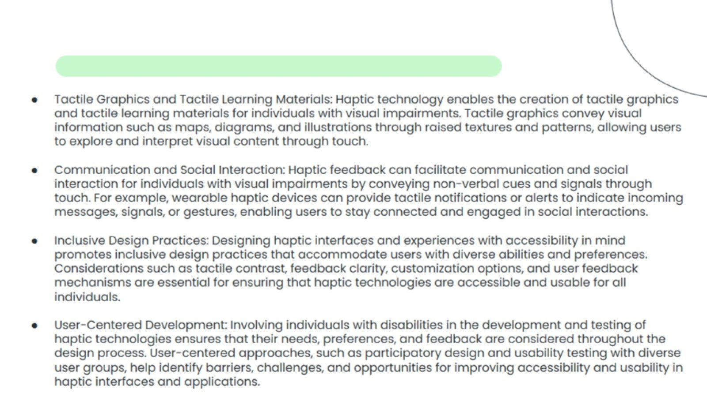

Slide 18
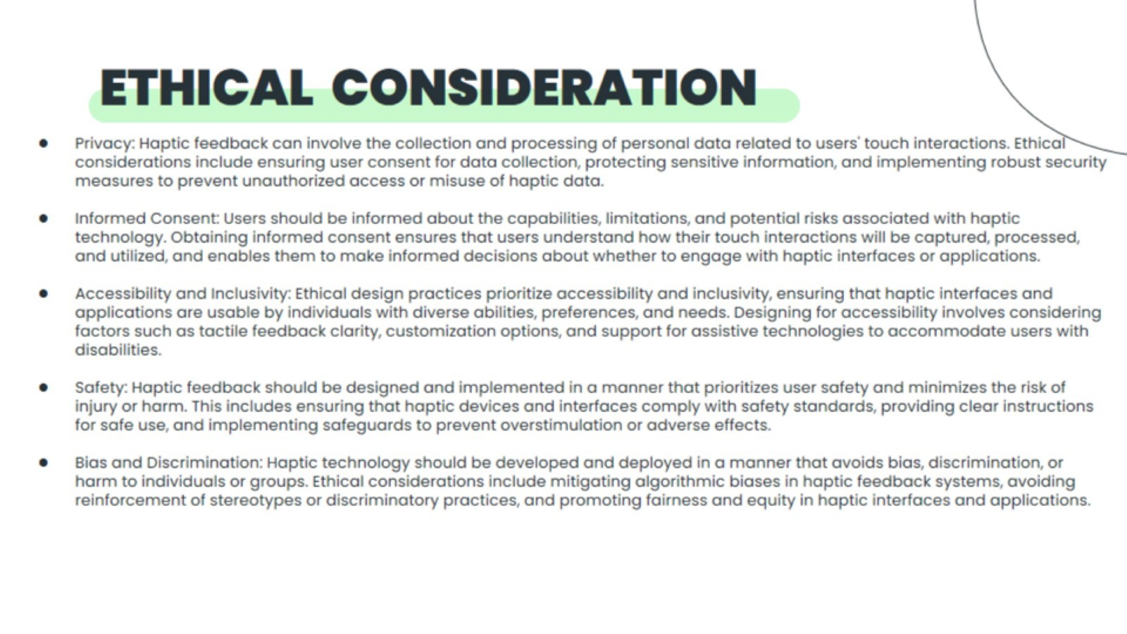
ETHICAL CONSIDERATION

Slide 19
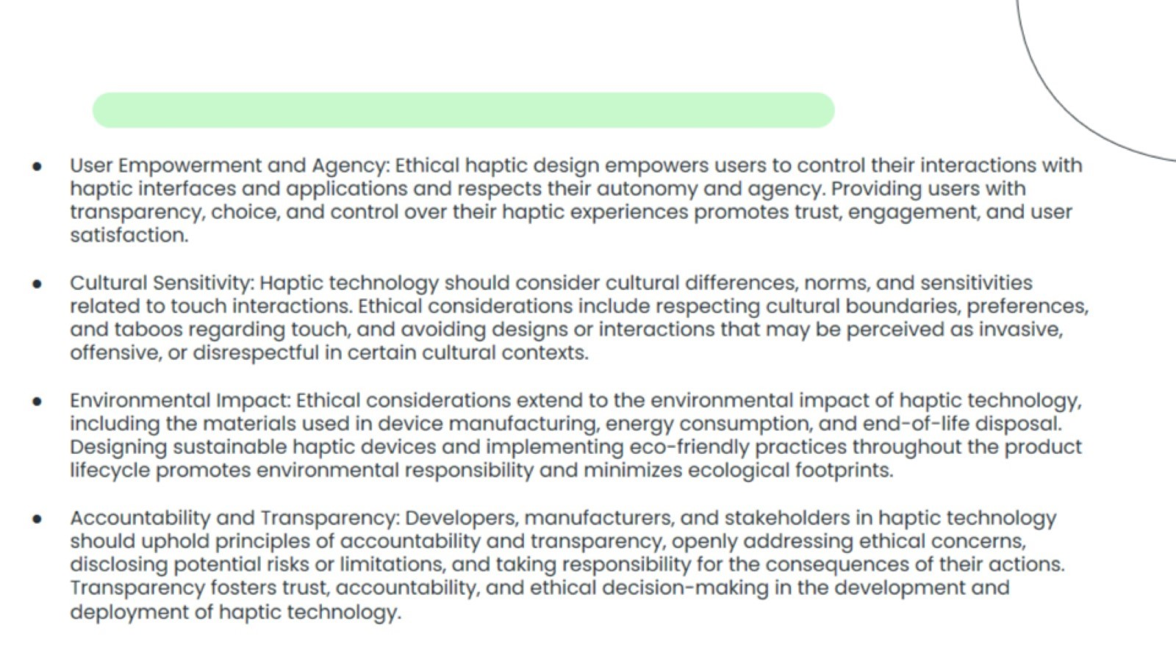

Slide 20
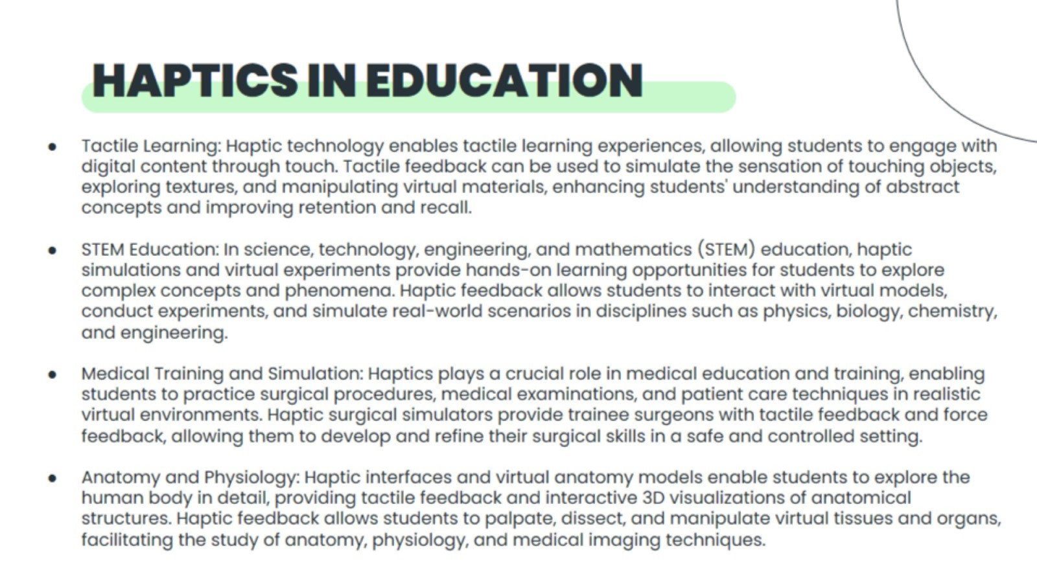
HAPTICS IN EDUCATION

Slide 21
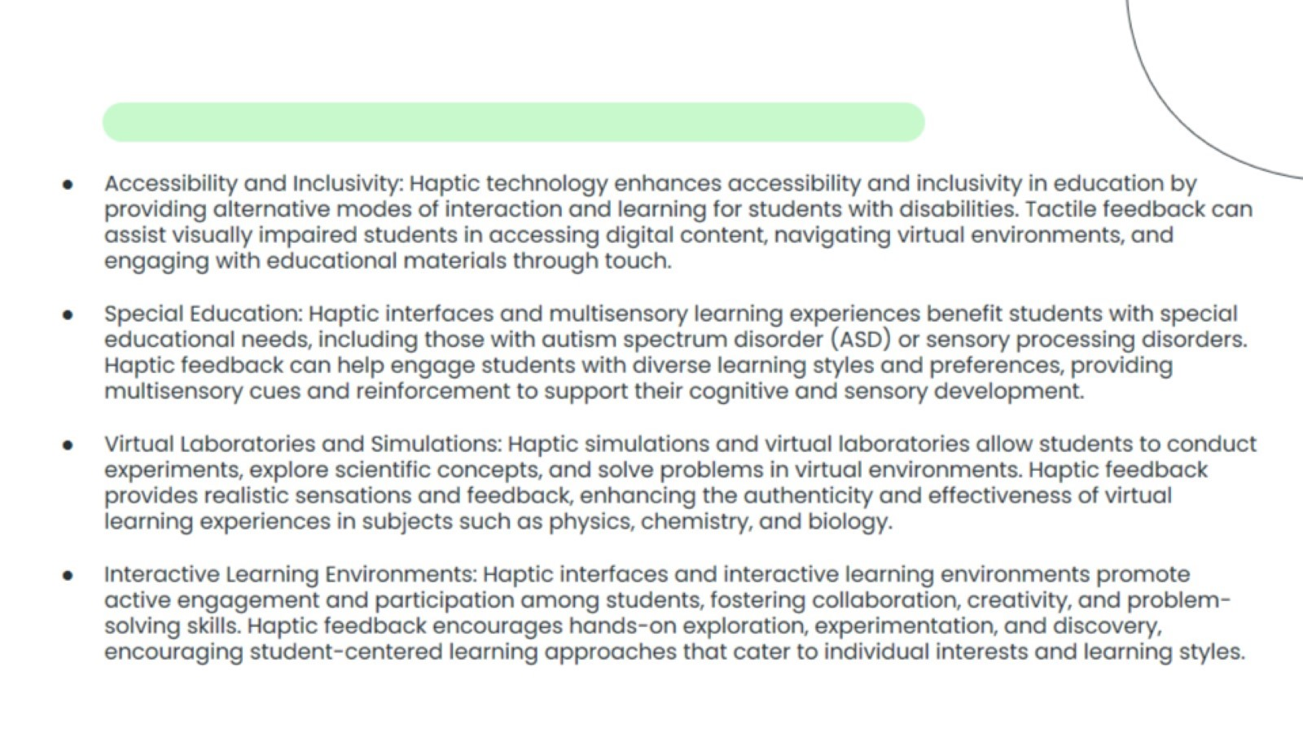

Slide 22
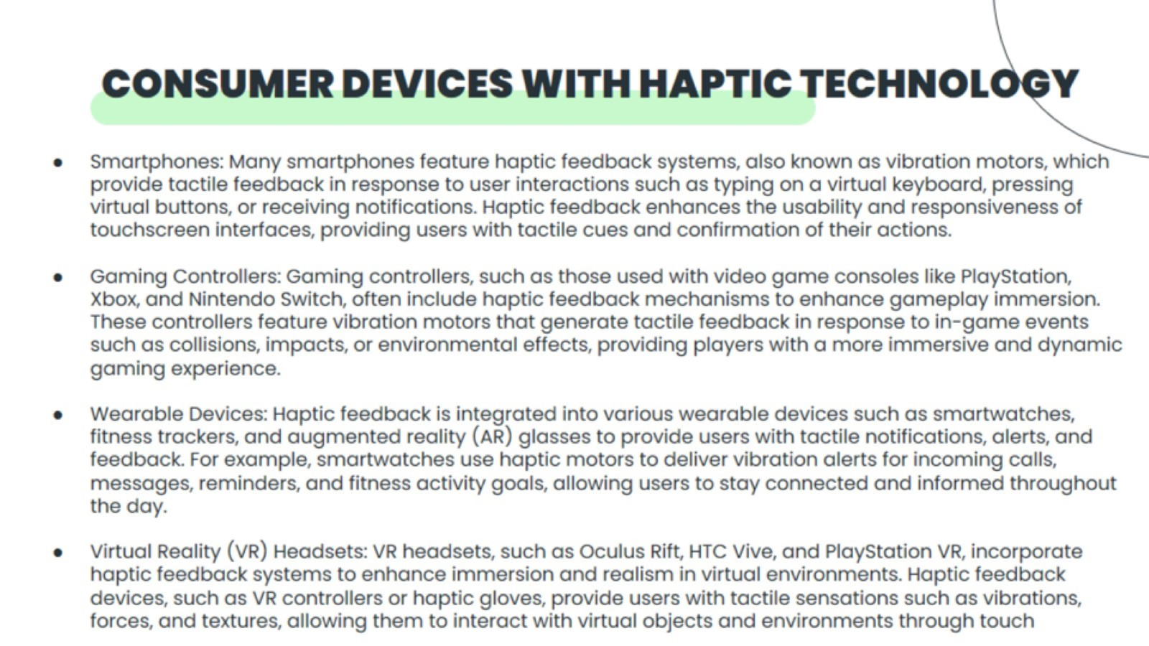
CONSUMER DEVICES WITH HAPTIC TECHNOLOGY

Slide 23
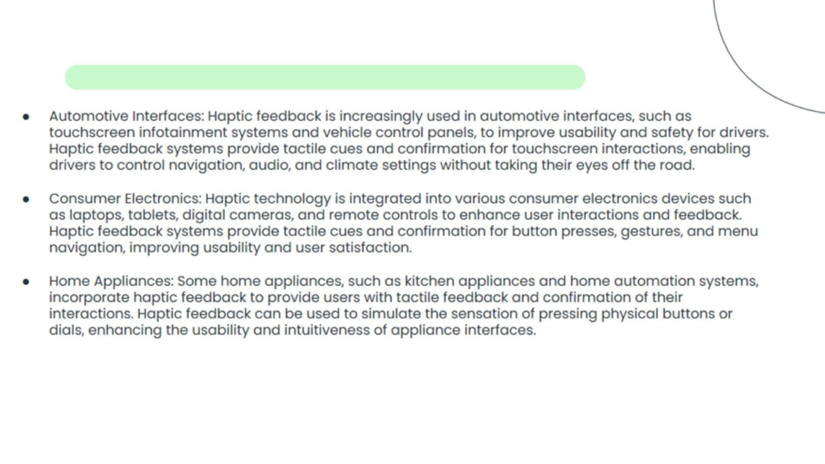

Slide 24
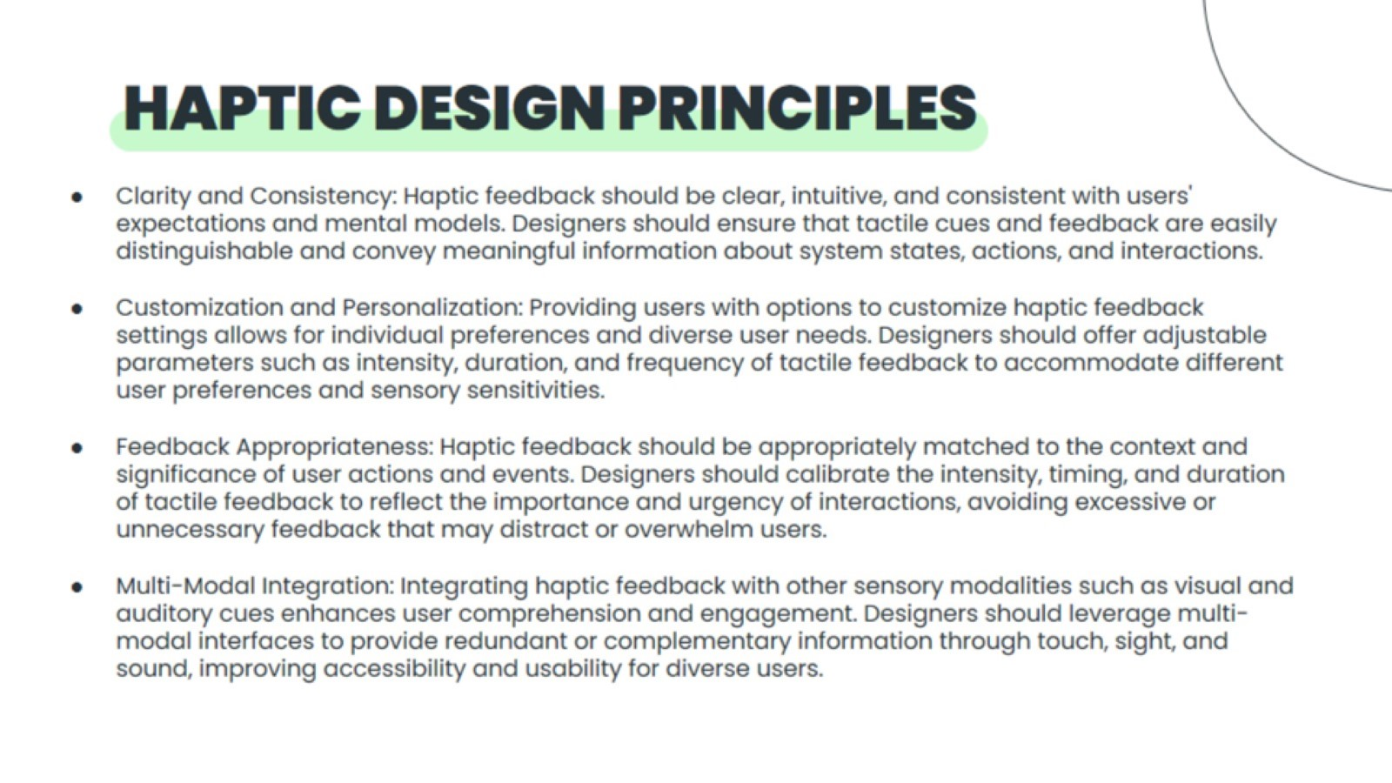
HAPTIC DESIGN PRINCIPLES

Slide 25


